Slide 1
Project Work -I
B.E (CSE (AI & ML)) –VII Sem
Project Coordinator
Dr. Sayyada Hajera Begum

Slide 2
Introduction
The final year main project work is divided into two parts:
  Project Work-1 in VII Sem
  Project Work-2 in VIII Sem

Slide 3
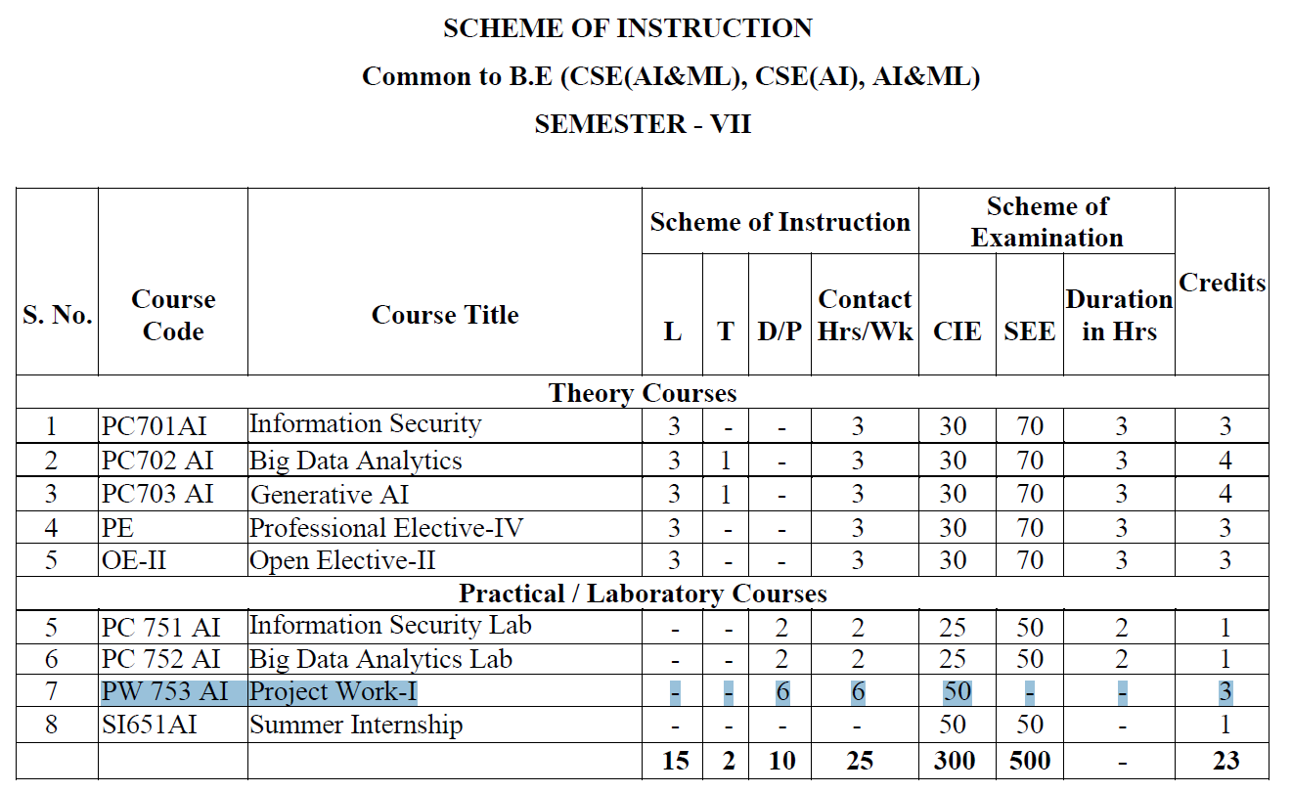

Slide 4
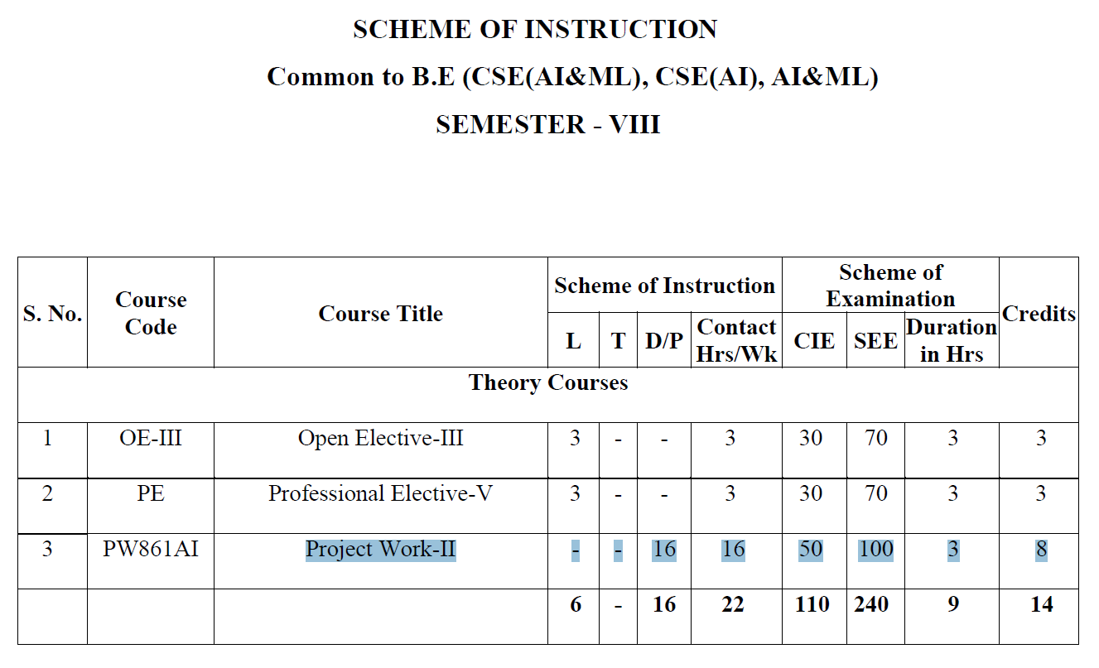

Slide 5
Project Work - I
Domain Identification
Finalizing Team (max 3 members)
Project Title Registration
Allotment of Guides
Base Paper research and seminar
Identifying objectives
Literature Survey
Literature Survey Seminar

Slide 6
Topic and Domain Identification
The topic and domain should be taken from a technical paper (called Base Paper) which should be published in a reputed journal on or after 2021.
The topic should be relevant and solvable.
It is advisable that the students approach a Project Supervisor for a suitable topic.
Define the problem statement and domain of base paper clearly.
Outline the expected outcome: Working prototype, Simulation, Product etc.

Slide 7
Project Registration
The project registration form will be shared on Google Classroom.
Duly filled and signed project registration form along with a copy of base paper should be submitted to Project Coordinator ( on or before the specified date).

Slide 8
Base Paper Seminar
All team members should be present on the given time and date of the seminar.
Note that the seminar will not be reconducted under any circumstances. Absentees will be given zero marks.
This will be a short seminar of 10 minutes duration.
Students are required to show a strong grasp of the problem statement of the base paper and its main findings.
The presentation template will be shared on Google Classroom.

Slide 9
Literature Survey
Once a base paper is identified, a thorough literature survey related to the base paper topic should be performed.
At least 10 quality papers published not earlier than 2021 should be surveyed.
A separate document detailing the steps to perform Literature Survey will be shared in google classroom.

Slide 10
S. No. | Author(s) & Year | Paper Title | Methodology/ Technique | Dataset | Key Findings | Limitations / Research Gap
1 | Author et al. (2024) | Title of Paper | CNN / ML / DL etc. | Dataset name/ Size | Main result/finding | Small Dataset
2 | Author et al. (2023) | Title of Paper | Proposed method | Dataset name/ Size | Main result/finding | Low Accuracy
3 | Author et al. (2023) | Title of Paper | Proposed method | Dataset name/ Size | Main result/finding | High Computational cost

Slide 11
Final Seminar
At the end of the literature survey phase the students should have identified the existing systems, its disadvantages, proposed system/ solution and its features.
Literature survey findings.
Architecture of the proposed system.
This seminar will be of 15 minutes duration.
The students should submit a report of the project work during seminar.
The presentation template for the seminar will be posted on Google Classroom.
Note that the seminar will not be reconducted under any circumstances. Absentees will be given zero marks

Slide 12
Thank You

